Slide 1

INTERFACING GSM SIM900 WITH ARDUINO MEGA
KIRANPREET KAUR GILL(C0761396)
GROUP #2

Slide 2
TABLE OF CONTENT
PROJECT OVERVIEW
UNTIL NOW
TASK OBJECTIVES
REQUIREMENTS
HARDWARE REQUIREMENTS
SOFTWARE REQUIREMENTS
INTRODUCTION OF ARDUINO MEGA
FEATURES
PIN LAYOUT
ARDUINO IDE
INTRODUCTION OF GSM SIM900 MODULE
FEATURES
PIN LAYOUT
WORKING OF GSM900 MODULE
GETTING STARTED WITH GSM MODULE
ROLE OF GSM MODULE
INTERFACING OF GSM MODULE WITH ARDUINO MEGA
SCHEMATIC DIAGRAM
CONNECTIONS
LIBRARIES INCLUDED FOR INTERFACING
AT COMMANDS
CODING
OUTPUT
TROUBLESHOOTING
REFERENCES

Slide 3
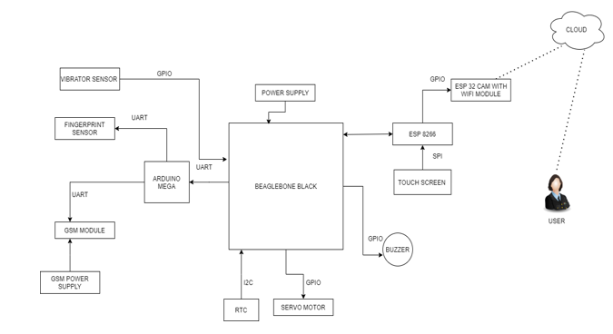
PROJECT OVERVIEW

Slide 4
UNTIL NOW…
After the successful interfacing of buzzer, Servo motor, Vibration sensor, Arduino mega and Fingerprint sensor, the next task is interfacing of GSM SIM900 with beaglebone black.
GPIO communications is used for interfacing of buzzer, Servo motor, Vibration sensor except the fingerprint sensor and Arduino Mega in which UART was used.
For interfacing of GSM SIM900 module with Arduino Mega UART communication protocol is used.

Slide 5
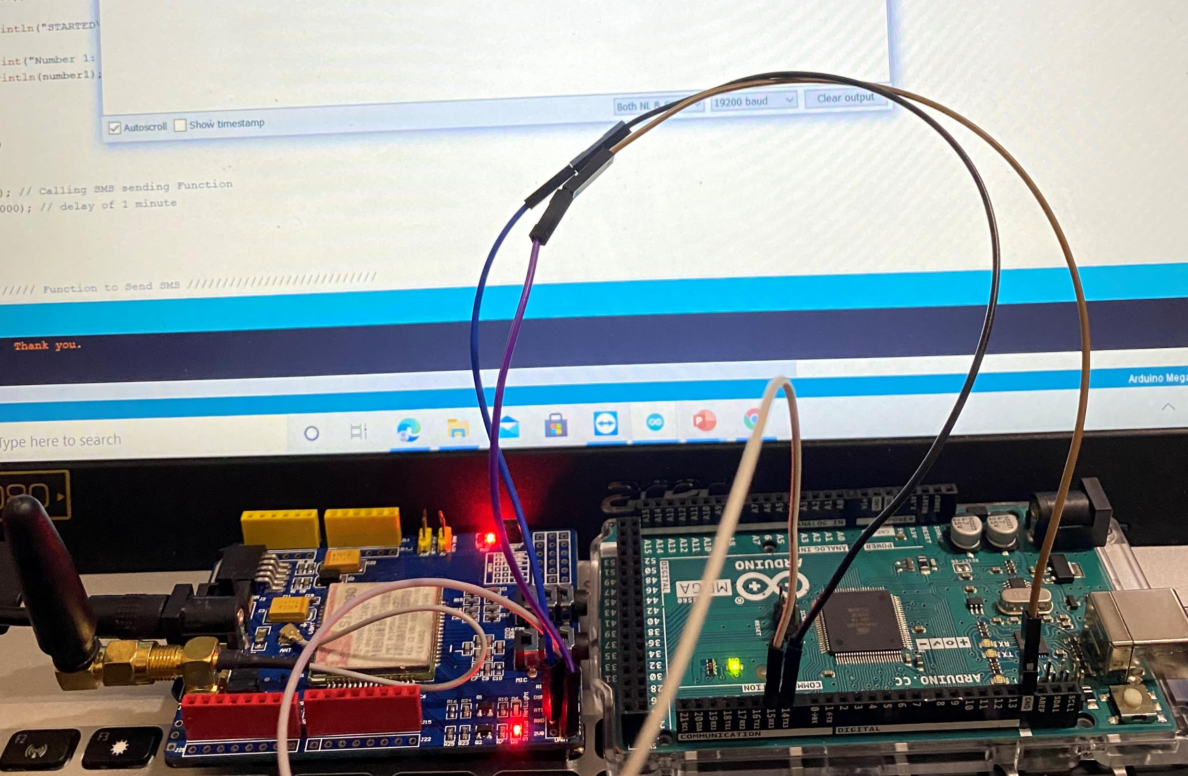
TASK OBJECTIVES
To interface the GSM(Global System for Mobile Communication) with the Arduino Mega.
The coding will be done to it compatible with the mentioned objective.
The interfacing is done so as to send the SMS(Short Messge Services) when the locker is opened.

Slide 6
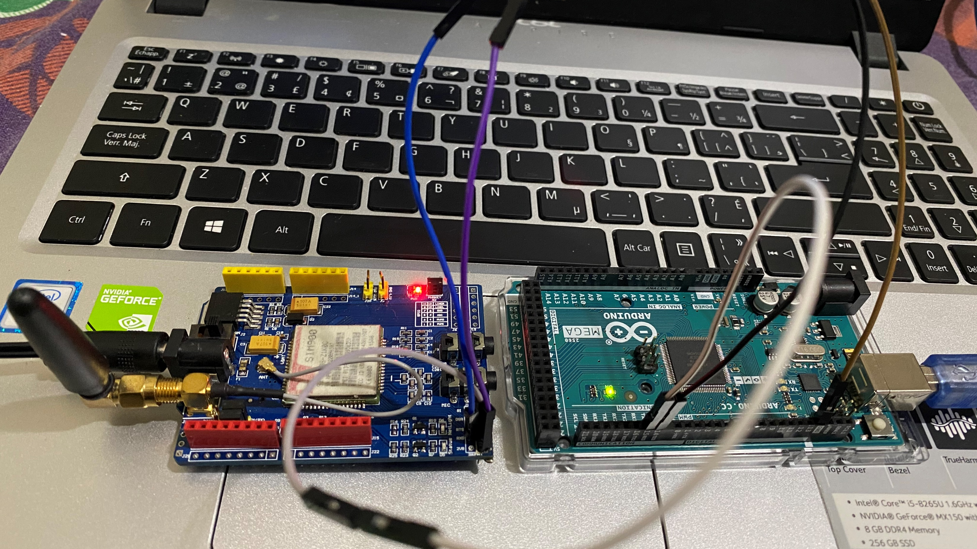
REQUIREMENTS
There are some hardware and software requirements for the interfacing of GSM Module with the Arduino mega.

Slide 7
HARDWARE REQUIREMENTS
Arduino Mega
GSM Module
5V adapter
USB Cable
Jumper Wires
Chatr Sim Card
Host machine

Slide 8

SOFTWARE
Arduino IDE
This Photo by Unknown Author is licensed under CC BY-SA

Slide 9
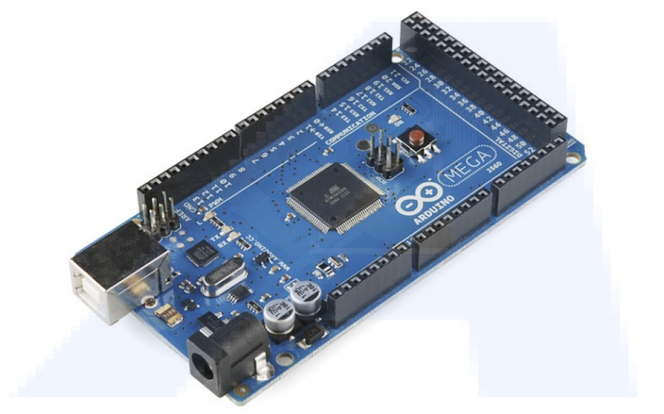
INTRODUCTION OF ARDUINO MEGA
Arduino mega 2560 R3 is the microcontroller unit in the embedded industry, which is the exact replica of Arduino UNO, but with a greater number of input/output pins and communication protocol.
For, this project, we are using Arduino mega as a slave device.
We are connecting the GSM Module with the Arduino mega using UART Communication protocol.
This Photo by Unknown Author is licensed under CC BY-SA

Slide 10
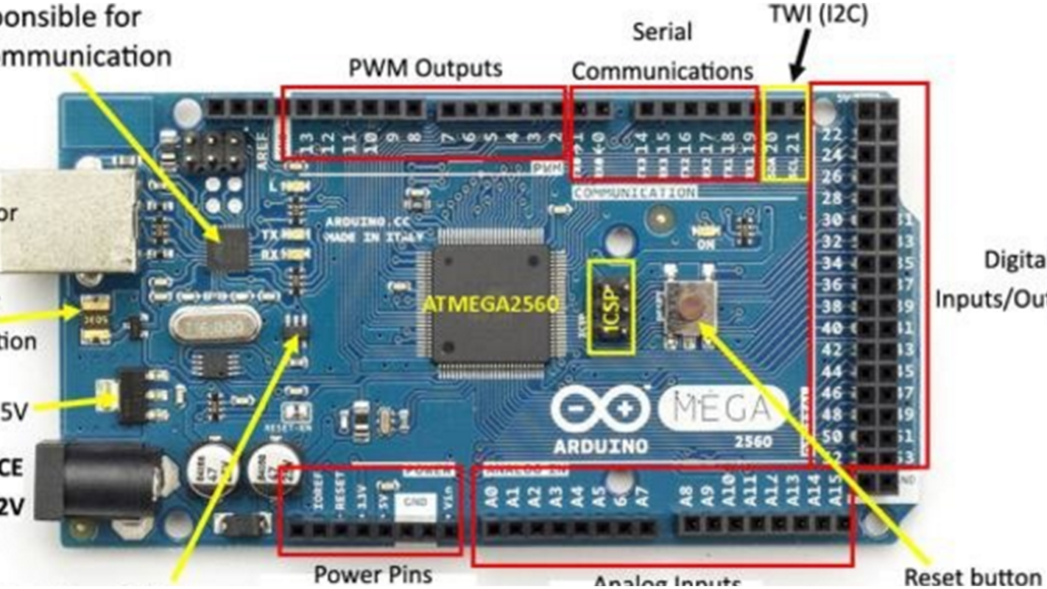
INTRODUCTION TO ARDUINO MEGA
The board has 54 digital input/output pins (of which 14 can be used as PWM outputs), 16 analog inputs, 4 UARTs (hardware serial ports), a 16MHz crystal oscillator, a USB connection, a power jack, and a reset button.

Slide 11
FEATURES
5V operating voltage
40mA DC current per I/O pin
256KB flash memory of which 8KB used by bootloader
8KB SRAM
4KB EEPROM
16Mhz clock speed

Slide 12
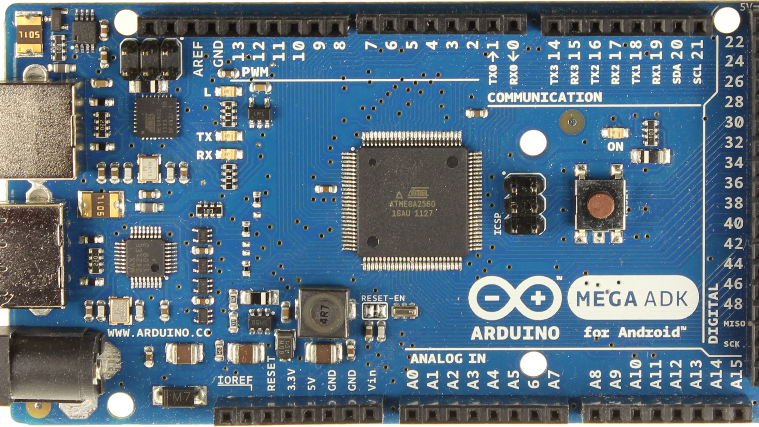

PIN LAYOUT
The pin14(transmitter pin), pin 15(receiver pin) of serial 3 and GND pin of Arduino Mega are used.

Slide 13
ARDUINO IDE
Arduino IDE is used in as a software in this interfacing to flash the code in the Arduino.
It is a cross platform for application for Linux , windows and macOS.
It is used to write and upload codes to Arduino boards of all kinds.
The Arduino IDE supports the languages C and C++ using special rules of code structuring.
Build in examples are provided for number of boards that can be easily accessed by connecting the development board with the host machine.
User-written code only requires two basic functions, for starting the sketch and the main program loop, that are compiled and linked with a program stub main() into an executable cyclic executive program with the GNU toolchain, also included with the IDE distribution
This Photo by Unknown Author is licensed under CC BY-SA

Slide 14
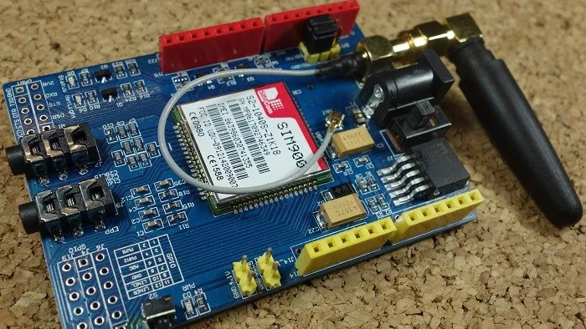
INTRODUCTION TO GSM MODULE
GSM stands for Global System for Mobile Communications and is the global standard for mobile communications.
GPRS stands for General Packet Radio Service. GPRS is a mobile service on the 2G and 3G cellular communication.
The GSM GPRS shield is particularly useful as it allows to:
Connect to the Internet over GPRS network
Send and receive SMS
Place and receive phones calls

Slide 15
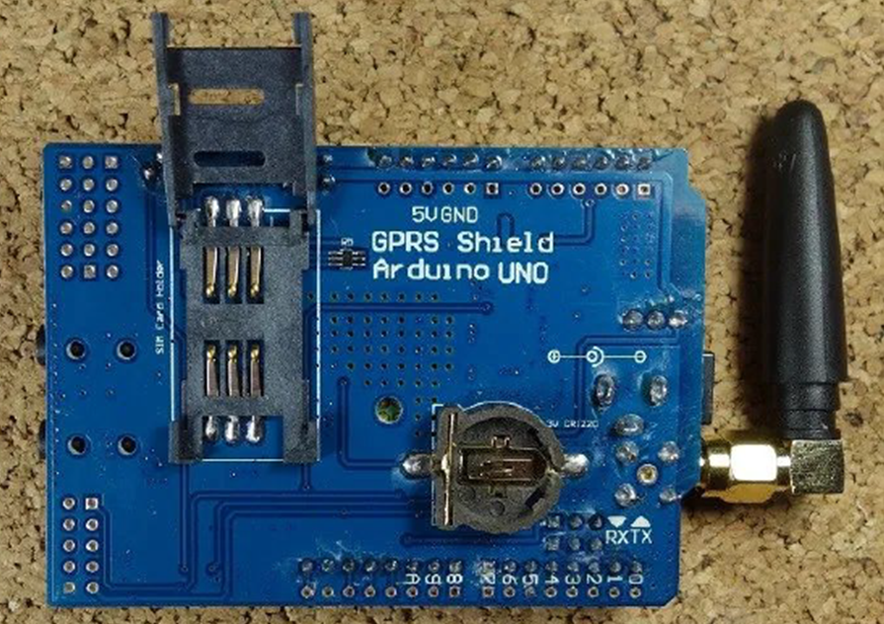
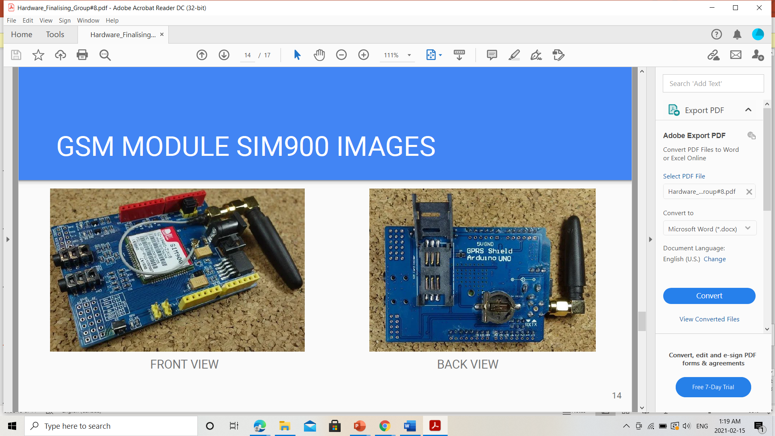
BACK &FRONT VIEW:GSM MODULE

Slide 16
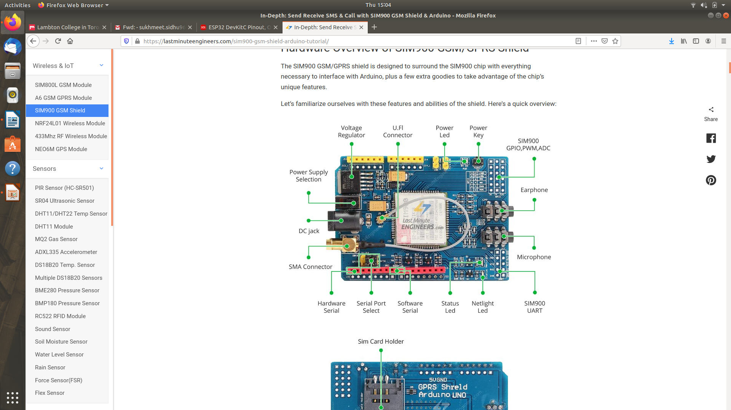
FEATURES
Compatible with Arduino and clones.
Allows you to send SMS, MMS, GPRS and Audio via UART using AT commands.
It has 12 GPIOs, 2 PWMs and buit-in ADC of the SIM900 module
Quad Band: 850; 900; 1800 and 1900 MHZ, so it should work in all countries with GSM (2G) networks
Control via AT commands.
Has microphone and headphone jacks for phone calls

Slide 17
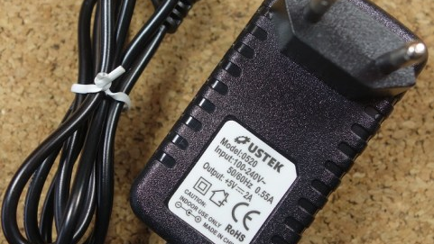
POWER ADAPTER FOR GSM MODULE
To power up the shield, it is advisable to use a 5V power supply that can provide 2A as the one shown below. It can also be powered with 9V 1A, or 12V 1A.

Slide 18
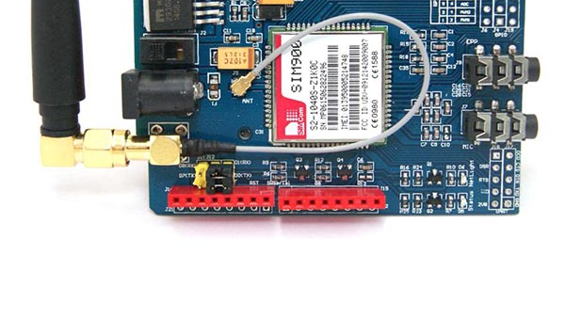
PIN LAYOUT
SIM transmitter pin, SIM receiver pin, and GND are used.

Slide 19
WORKING: GSM MODULE
Before interfacing GSM module, its important to understand the working of GSM module.
Initially, the power adapter is required to power up the GSM module. Next, we need to check with the LED status. If there is no LED status then the perpendicular power button should be hold for 2 seconds approximately.

Slide 20
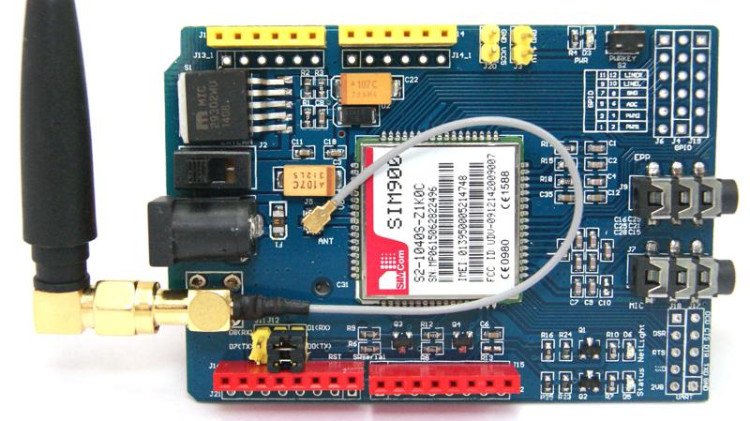
WORKING: GSM MODULE
PWR: This LED is connected to the shield’s power supply line. If it is “ON” then the shield is receiving power.
Status: It indicates the working status of SIM900. If it is “ON” the chip is in working mode.
Netlight: It indicates the status of cellular network. It will blink at various state it’s in.
OFF : the SIM900 is not working.
64ms ON, 800ms OFF: The SIM900 chip is running but not register to the cellular network.
64ms ON, 3seconds OFF: The SIM900 chip is registered to the cellular network and can send/receive voice and SMS.
64ms ON, 300ms OFF: The GPRS data connection you requested is active.
When supplying power externally through an adapter make sure that you have made the switch on the external mode.
This Photo by Unknown Author is licensed under CC BY

Slide 21
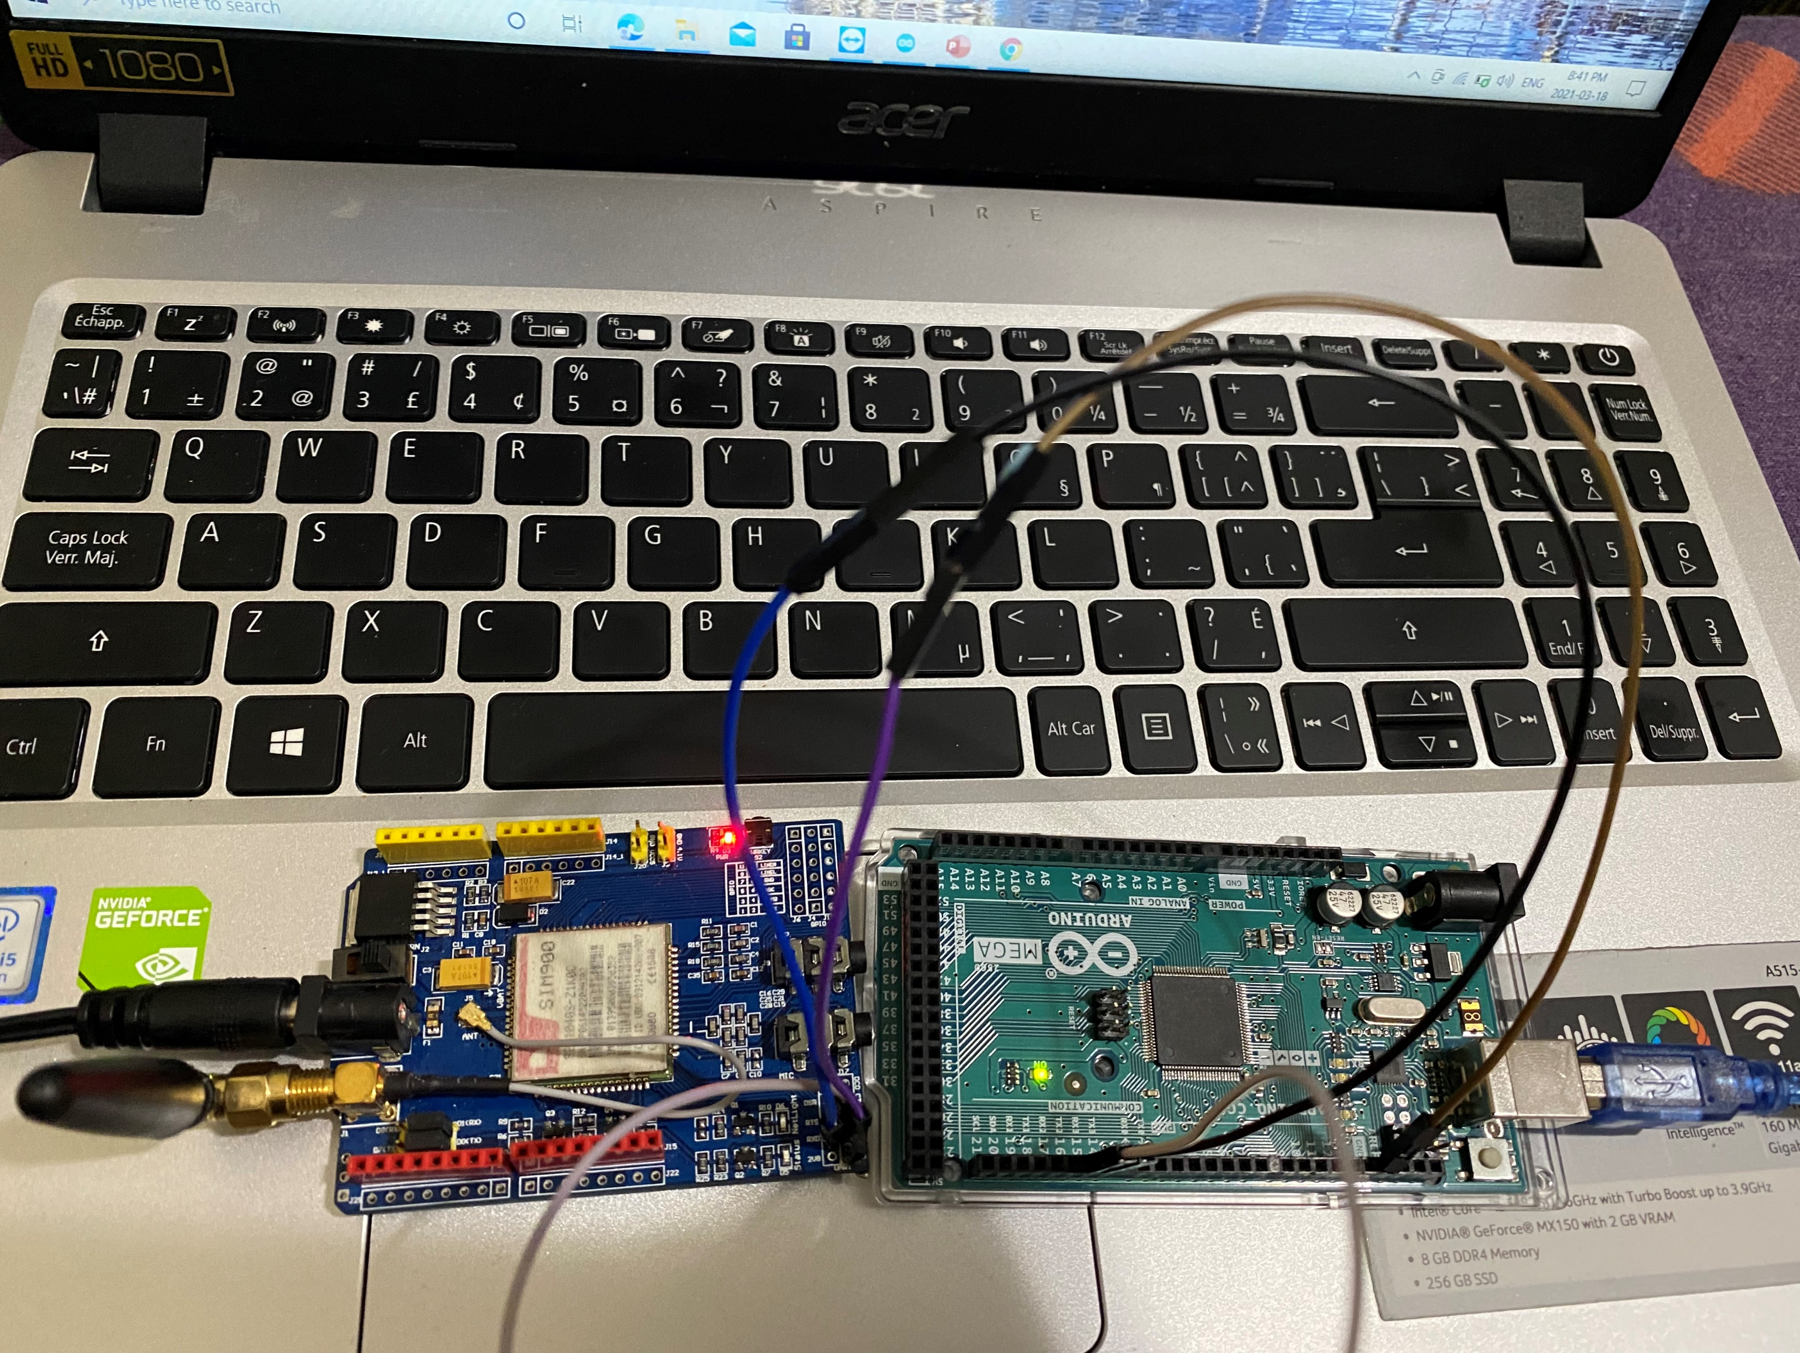
ROLE OF GSM MODULE
This module is used to send SMS (Short Service Message) to the user whenever the locker is opened.

Slide 22
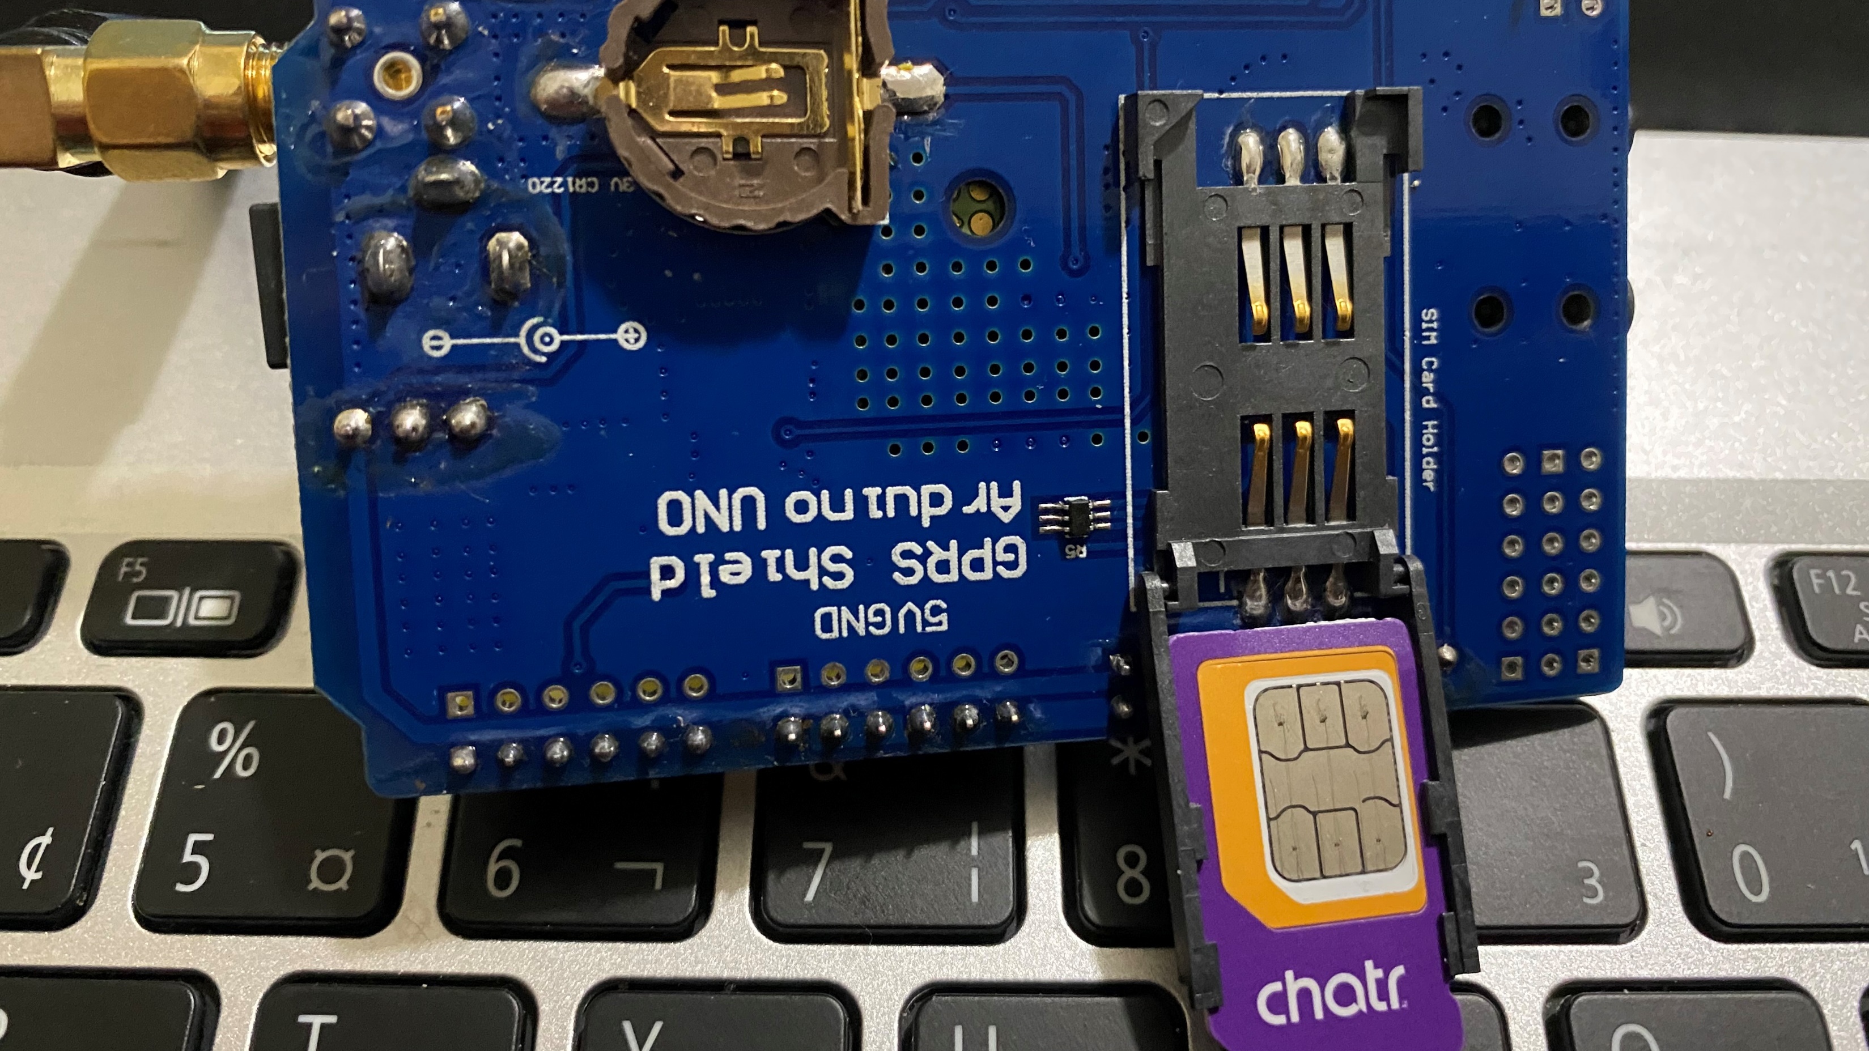
GETTING STARTED GSM MODULE
STEP 1: Insert the SIM card into the SIM card holder – make sure you’ve read the preliminary steps in the previous section.
STEP 2: Make sure the antenna is well connected.

Slide 23
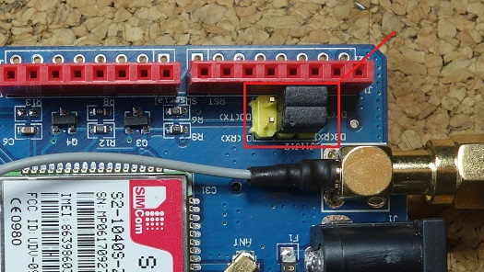
GETTING STARTED WITH GSM MODULE
STEP 3:On the serial port select, make sure the jumper cap is connected as shown in figure below to use software serial.

Slide 24
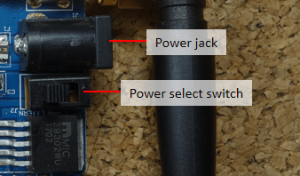
GETTING STARTED WITH GSM MODULE
STEP 4: Power the shield using an external 5V power supply. Make sure you select the external power source with the toggle switch next to the DC jack.
STEP 5: To power up/down the shield press the power key for about 2 seconds.

Slide 25
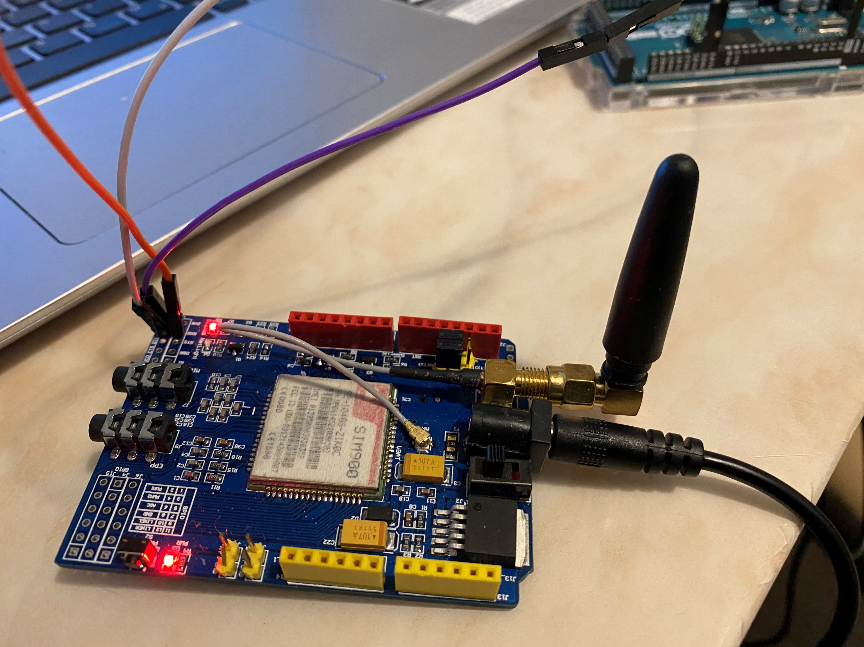
GETTING STARTED WITH GSM MODULE
STEP6: Then, the Status LED will light up and the NetLight LED will blink every 800 ms until it finds the network. When it finds the network, the NetLight LED will start blinking every three seconds.

Slide 26
COMMUNICATION PROTOCOL
UART is Universal Asynchronous receiver transmitter.
It is used to transmit the data in the form of packets .
For this project, we are using UART Communication protocol for Arduino mega and GSM 900 module.

Slide 27

UART COMMUNICATION
Arduino Mega has 4 UART Ports available, and we are using SERIAL 2 to perform the communication.
The Serial port 3 has pin 14- TX and Pin 15- RX
These pins are connected to the GSM module at odds to lead the UART communication possible.

Slide 28
INTERFACING OF ARDUINO MEGA AND GSM SIM900 MODULE
ARDUINO MEGA | GSM MODULE
PIN 15 | SIM Tx
PIN 14 | SIM RX
GND | GND
We are using GSM SIM 900 Module for this project to send SMS, when something wrong happen an email will be send to the owner.
Protocol used for communication is UART.
GSM need 5V power supply that is supplied by the 5V adaptor.

Slide 29
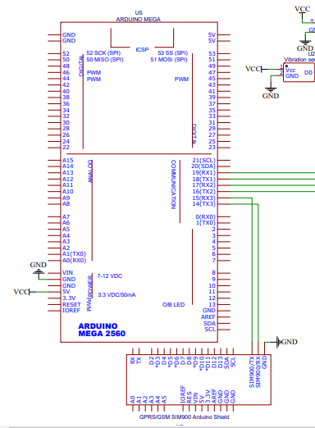
SCHEMATIC DIAGRAM

Slide 30
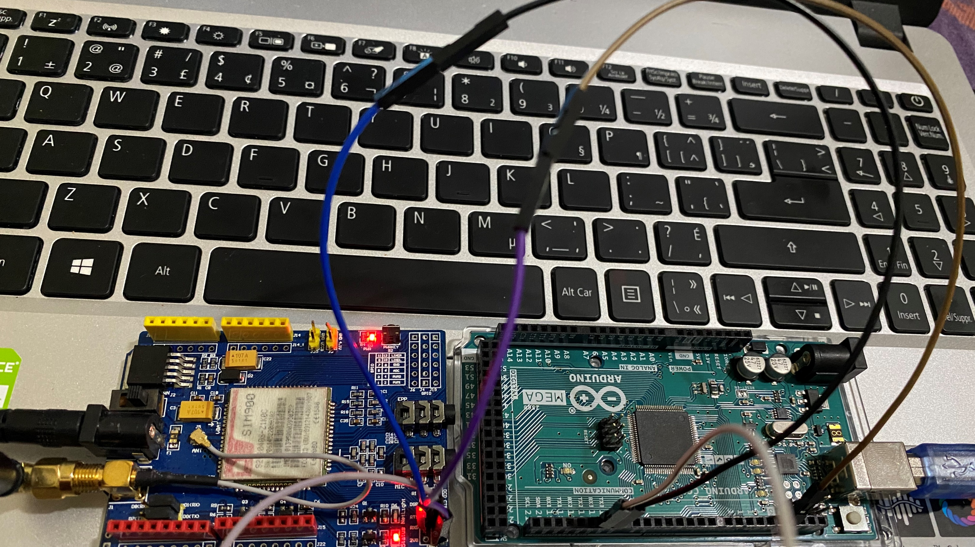
CONNECTIONS OF ARDUINO MEGA AND BEAGLEBONE BLACK

Slide 31
LIBRARIES USED FOR THIS INTERFACING
For interfacing of GSM SIM 900 module, there are libraries that are available but in this interfacing no library is required. The reason for that is there are various AT commands which are used as they are specific commands for doing things.
Due to different version of GSM, all of them support a little bit of different commands, that increases the complexity of programming so AT commands make it quite simple.

Slide 32

AT COMMANDS: BRIEF INTRODUCTION
AT commands are instructions used to control a modem. Every command line starts with "AT" or "at” therefore, these modem commands are called AT commands.
Besides this common AT command set, GSM/GPRS modems and mobile phones support an AT command set that is specific to the GSM technology, which includes SMS-related commands like AT+CMGS (Send SMS message), AT+CMSS (Send SMS message from storage), AT+CMGL (List SMS messages) and AT+CMGR (Read SMS messages).
the starting "AT" is the prefix that informs the modem about the start of a command line. It is not part of the AT command name. For example, D is the actual AT command name in ATD and +CMGS is the actual AT command name in AT+CMGS

Slide 33
AT COMMANDS: BRIEF INTRODUCTION
The main purpose of the task is to send SMS to the desired number.
In addition to that, there are various tasks that can be performed by GSM/GPRS are listed below:
Get basic information about the mobile phone/modem(+CGMI, +CGMM, +CGSN, +CGMR)
Get information about the subscriber such as IMSI number(+CIMI).
Get the current status.
Send and receive fax.
Send , read, write or delete SMS messages and obtain notifications of newly received SMS messages.

Slide 34
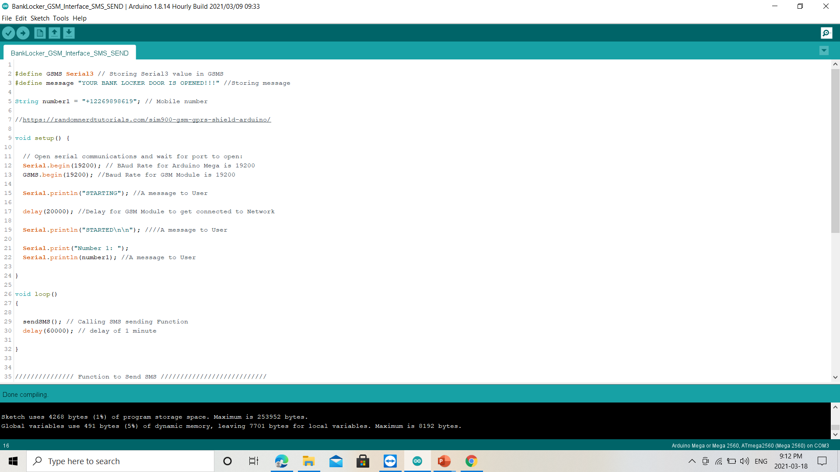
CODING

Slide 35
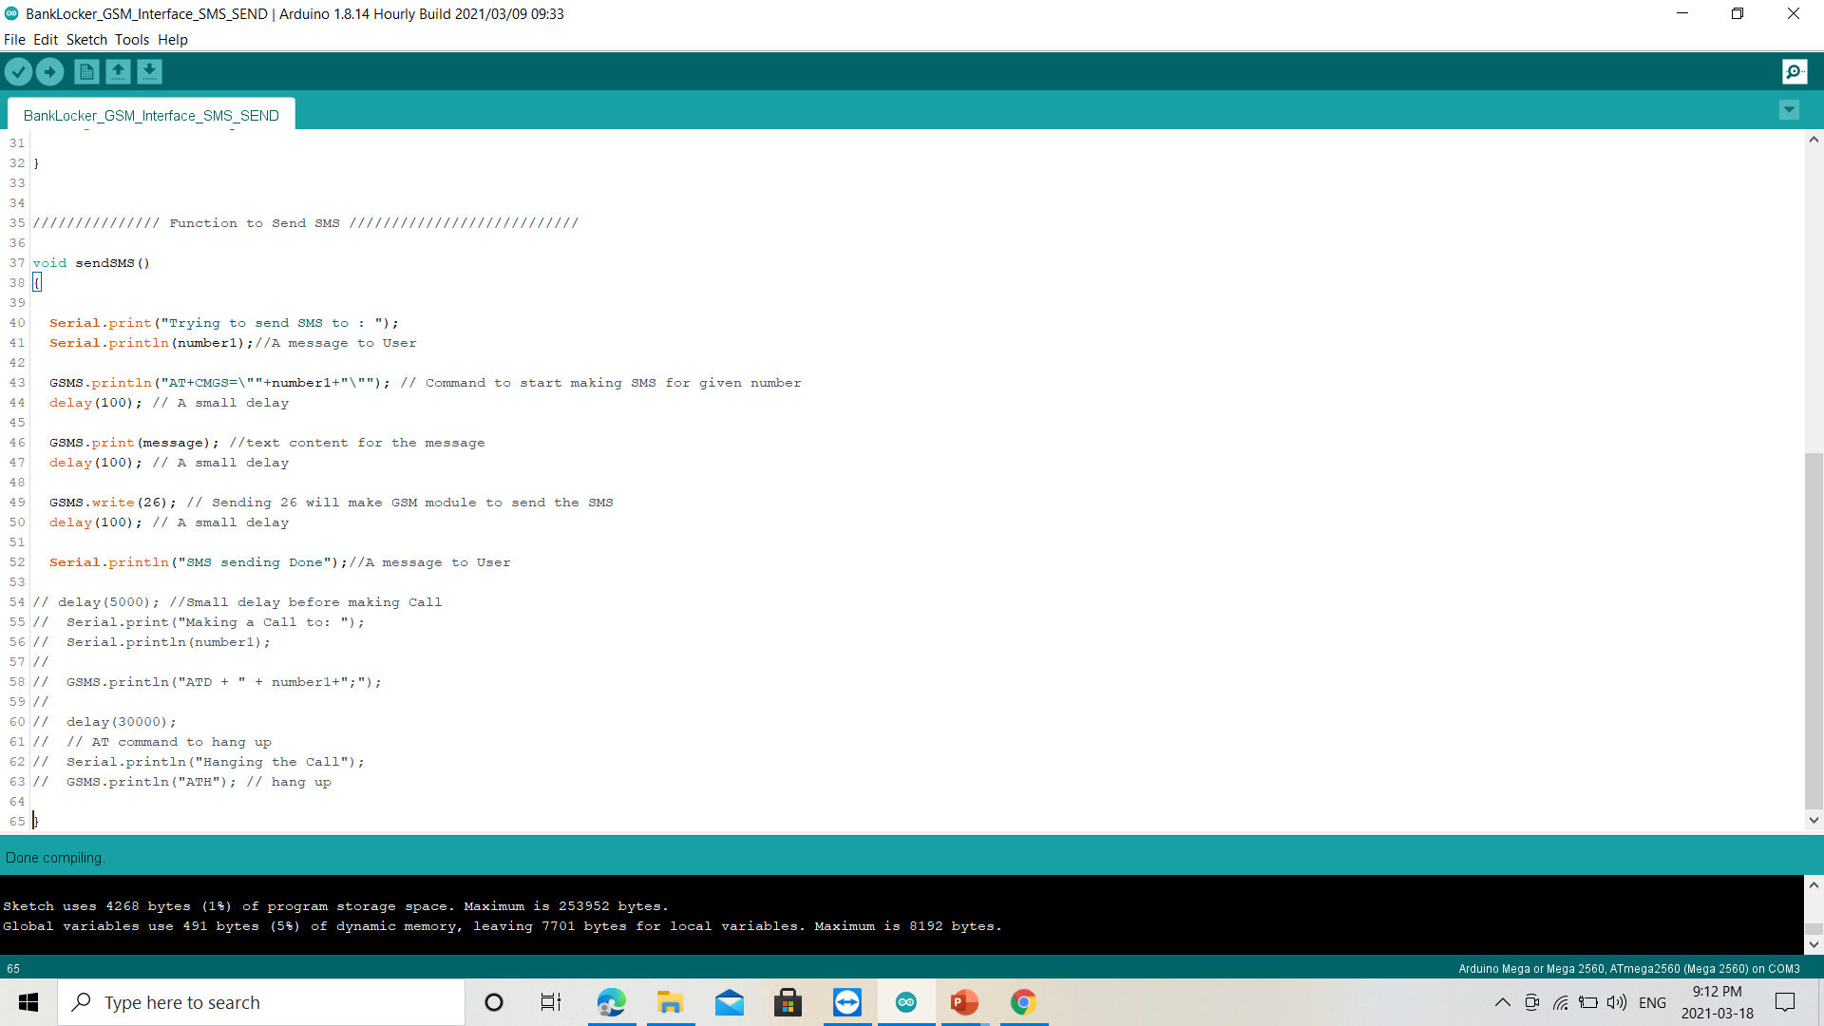
CODING
To make a call

Slide 36
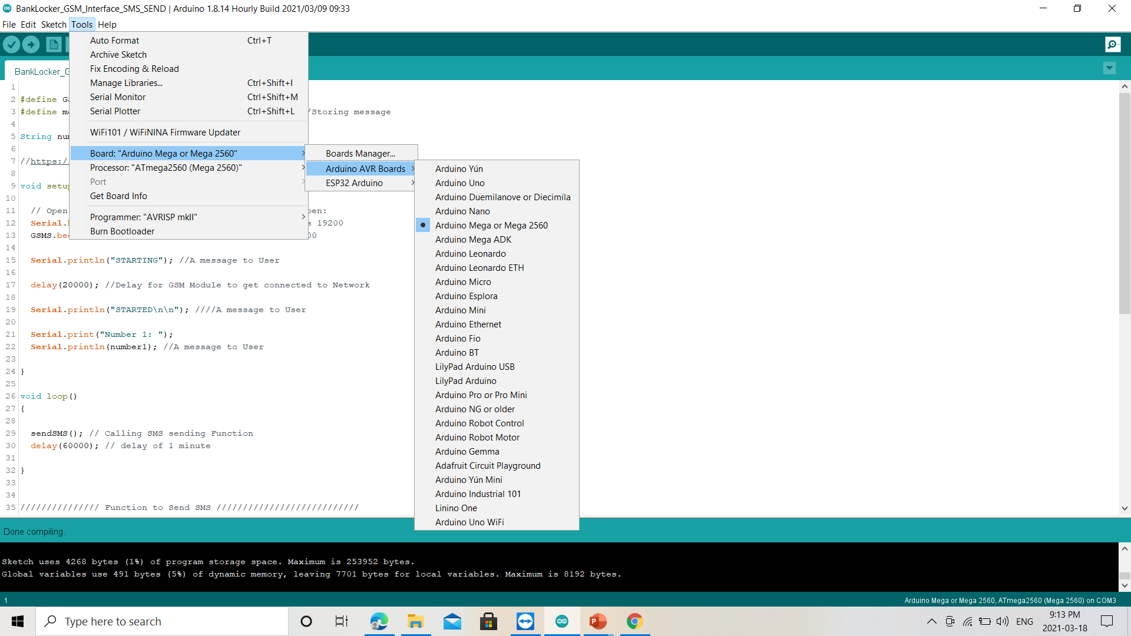
CODING
Before execution and compiling, cross-check with the board that the board which is selected is the right one such as in this task Arduino Mega is used.

Slide 37
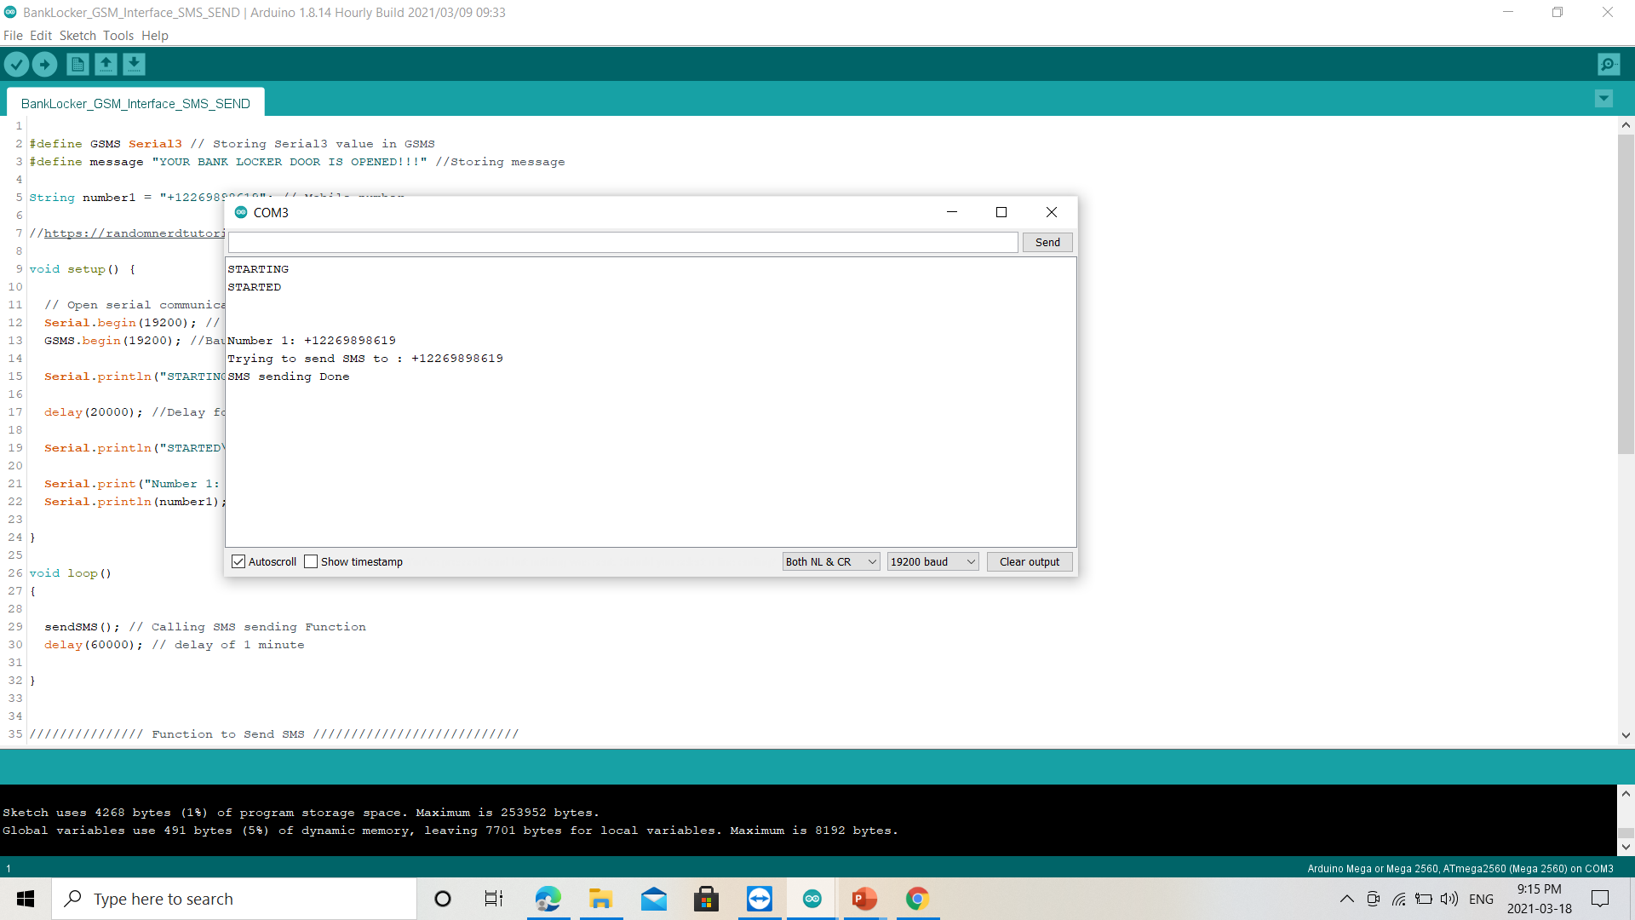
OUTPUT

Slide 38
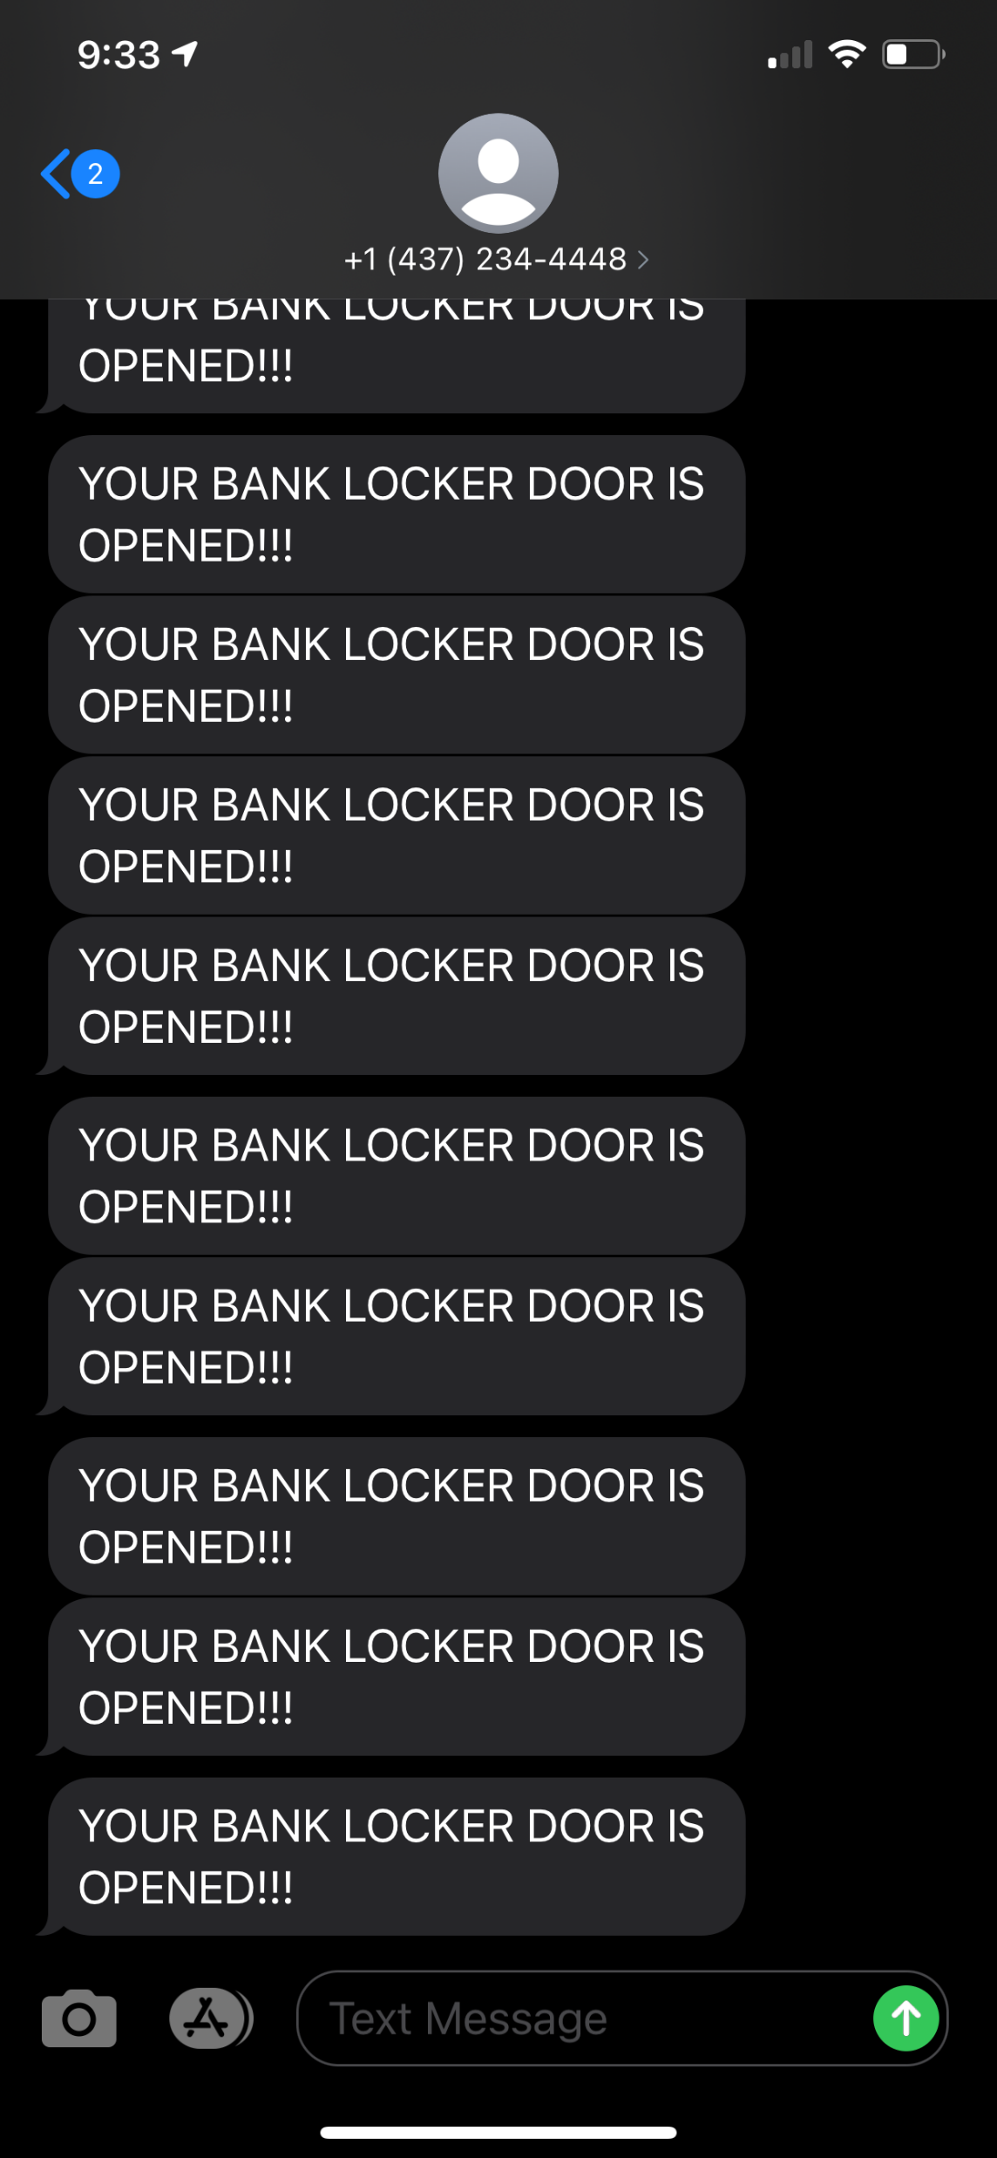
OUTPUT: TEXT MESSAGE RECEIVED

Slide 39

TROUBLESHOOTING
While making connections, make sure you connect the TX and Rx of GSM SIM900 to the Rx and Tx of Arduino Mega, respectively.
To see the messages in the serial monitor, the shield and the Arduino’s serial port baud rate should be the same. The SIM900 GSM GPRS shield default baud rate is 19200. So, select the Arduino’s baud rate to 19200.

Slide 40
REFERENCES
Interfacing of Arduino Mega with GSM Sim900: SIM900 GSM GPRS Shield with Arduino | Random Nerd Tutorials
Arduino Mega: Arduino – ArduinoBoardMega
Video Link: Arduino gsm module making a call SIM 900 - Bing video
AT commands: http://www.developershome.com/sms/atCommandsIntro.asp

Slide 41
THANK YOU

